Slide 1
Online Bookstore
1352830 张志豪
1354202 王雨晴
1152792 吴昊天

Slide 2
Functionalities

Slide 3
1.Sign Up and Sign In.
2.Manage your own orders and information.
3.Check your shopping mart.
4.Buy what you want.

Slide 4
database
design

Slide 5
:::::::entity:::::::
users
category
books
shopping cart
orders

Slide 6
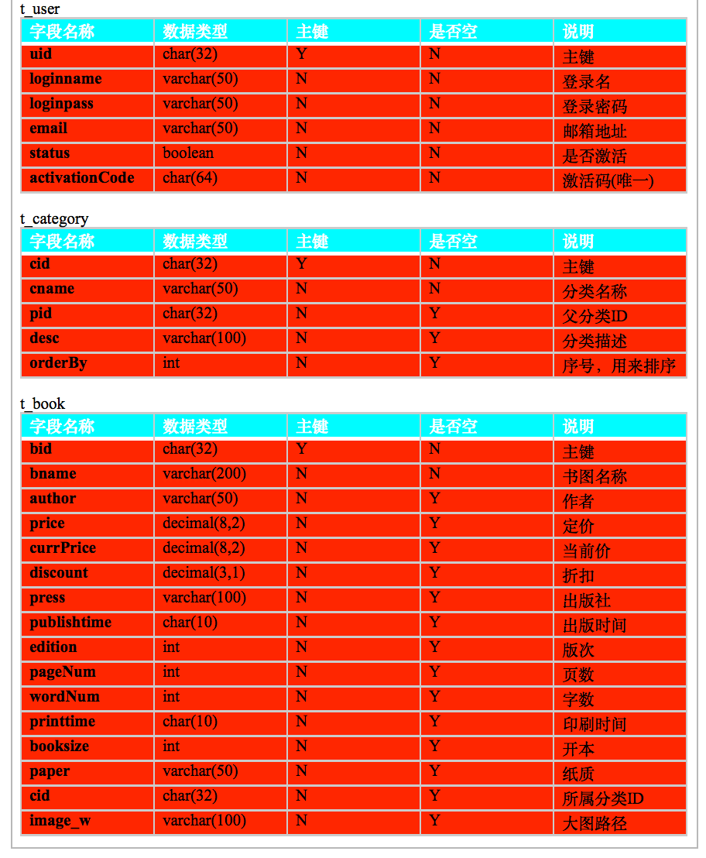
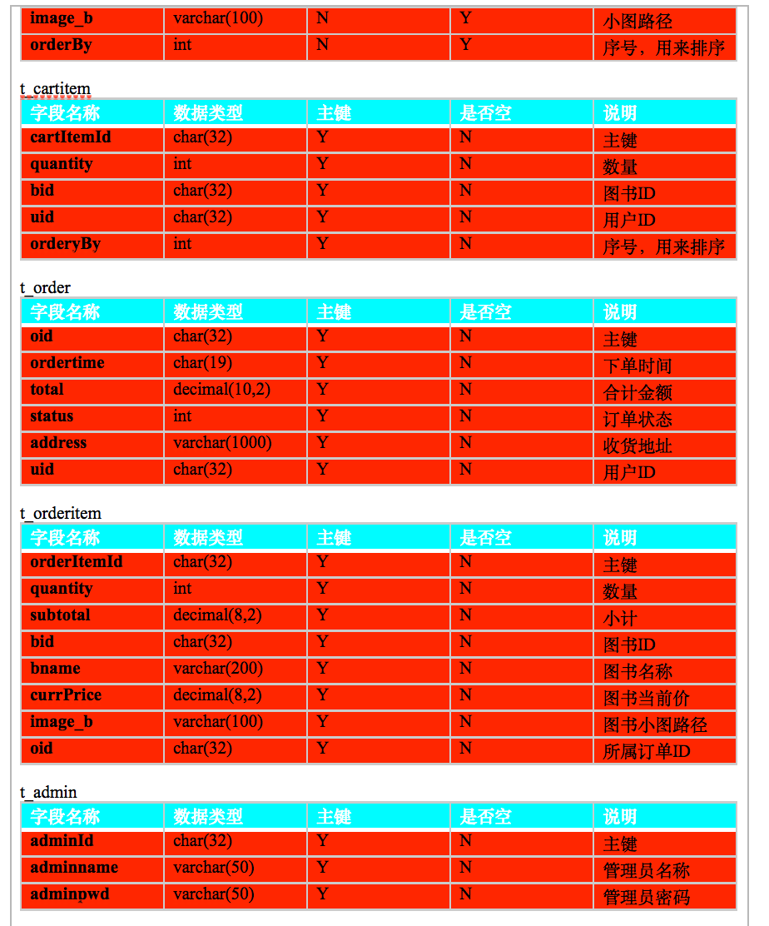

Slide 7
WorkFlow

Slide 8
Sign Up
Sign In
Manage goods and information.
check your shopping cart.

Slide 9
Plan and Schedule
Plan ：
1.We plan to use knowledge of JavaEE.
2.We also need the knowledge of JavaScript CSS3 and HTML to help us to finish this project.
3.Database -- MySQL.
4.Server -- Apache Tomcat.

Slide 10
Thank for your time!

